Slide 1
PREDICTION FOR CANCELLATION STATUS OF HOTEL BOOKINGS
Praveen kumar g
119ec0035

Slide 2
Libraries that has used foR the prediction
Numpy
Pandas
Matplotlib
Seaborn
Scikit

Slide 3
Exploring the dATA and visualization
Our data consists of 32 traits for predicting hotel booking cancellations.
These 32 features explain the various dimensions of hotel bookings from various perspectives.
Our dataset includes features such as arrivals, stays, cancellations, and reservations.

Slide 4
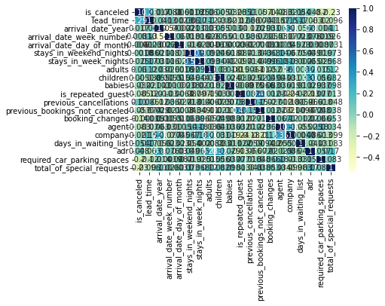
Correlation visualization
It is used to determine change one variable is it affect another variable.It will be ranging from -1 to +1

Slide 5
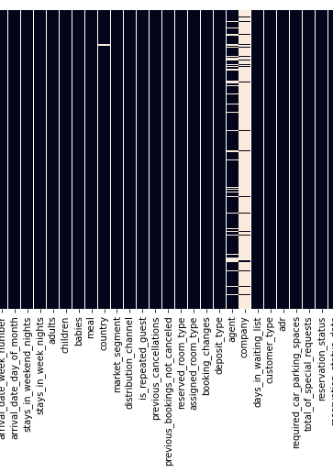
Heatmap (NULL DATA VISUALIZATION)
While checking the null values for the features ,we have got
Features null values
Children 4
Country 488
Agent 16340 company 112593
Remaining features 0

Slide 6
Inference of the data
First, we associated the features of the dataset to obtain the relationships between the features.
Then we checked the null-values of all features and discovered that the feature named 'company' has a high number of null values. As a result, we can remove that company feature from the dataset.
Remaining features that consist of null values ​​are replaced with the median/mode/mean of the remaining non-null data for that feature.

Slide 7
Data Preprocessing
Our data contains a variety of datatypes. We use label encoder to convert to a single datatype.
By fit_transform, we can get all the features to a same datatype.
Without datapreprocessing we cannot proceed to nextstep,It will be difficult to apply machine learning algoritms on the dataset.

Slide 8
Splitting the data
It uses two variables X and Y.
Y for "undone" features only, X for remaining features
Next step is to split the X into train data and test data with testdata size : 0.4
Similarly,Y is split into train data and test data with testdata size : 0.4

Slide 9
Checking for Algorithms
We will use various classifiers imported from scikit libraries to improve accuracy.
First,we have used logistic regression got test accuracy score and train accuracy score around 0.989.
Then we have gone through several classifiers in order to improve the accuracy score than the logistic regression.
The decision tree has an accuracy value of 100% and acts as a decision tree classifier in the model.

Slide 10
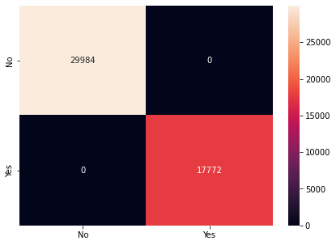
Confusion matrix for decision tree

Slide 11
conclusion
It divides the dataset into smaller subsets while step-by-step creating associated decision trees.
Here we have used the criterion ‘gini’ and max depth 3.
Thus,By accuracy score and confusion matrix we can conclude that decision tree classifier is the best.

